Slide 1
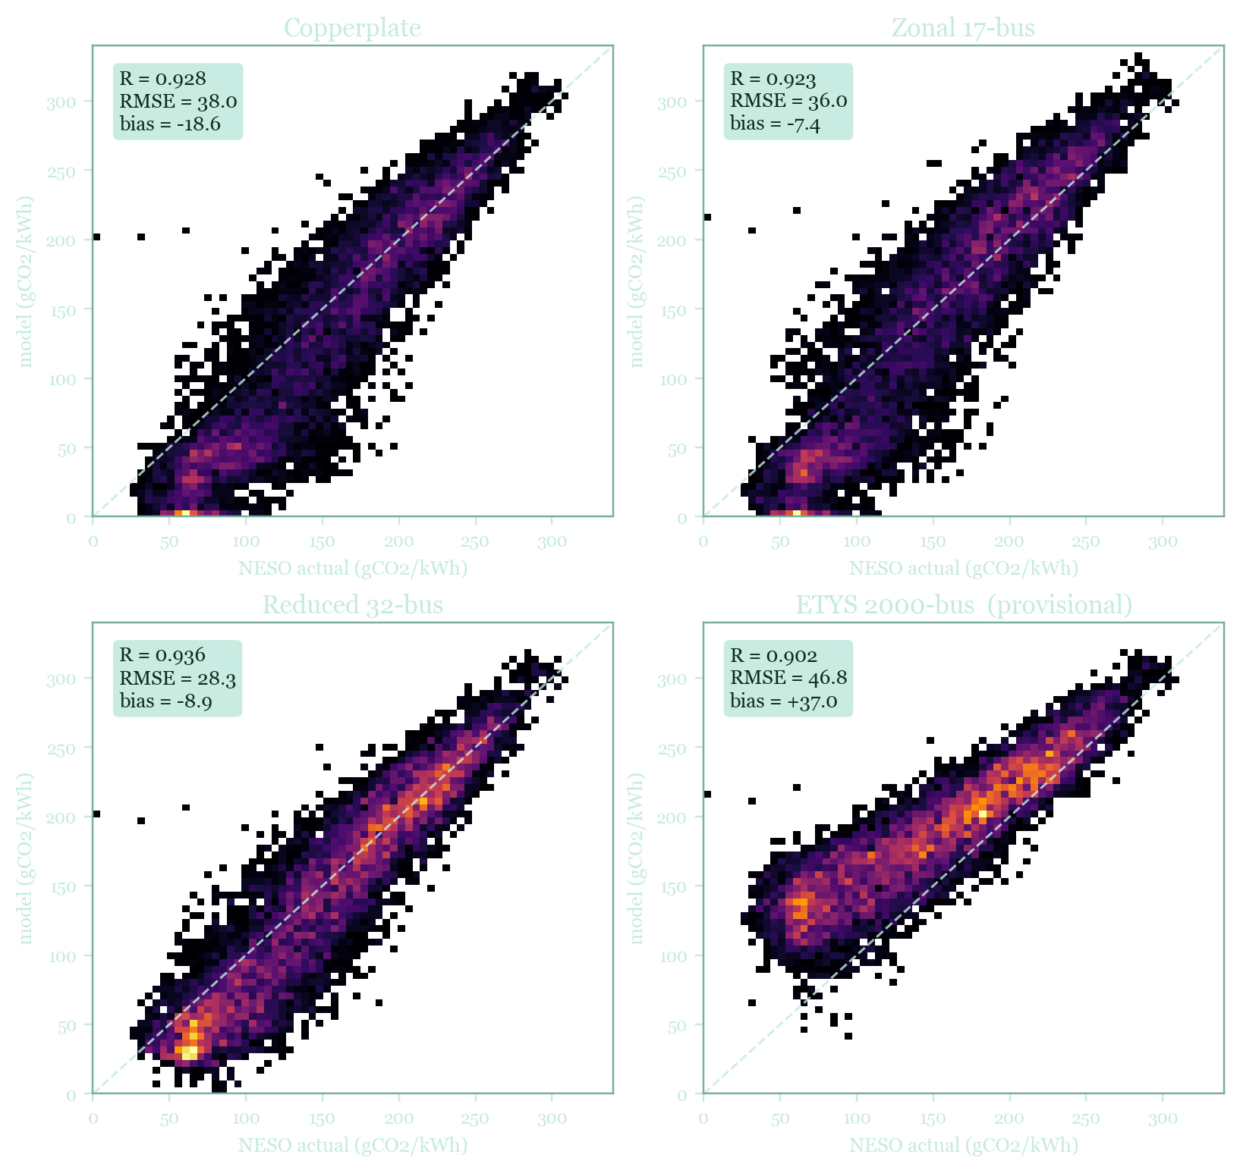
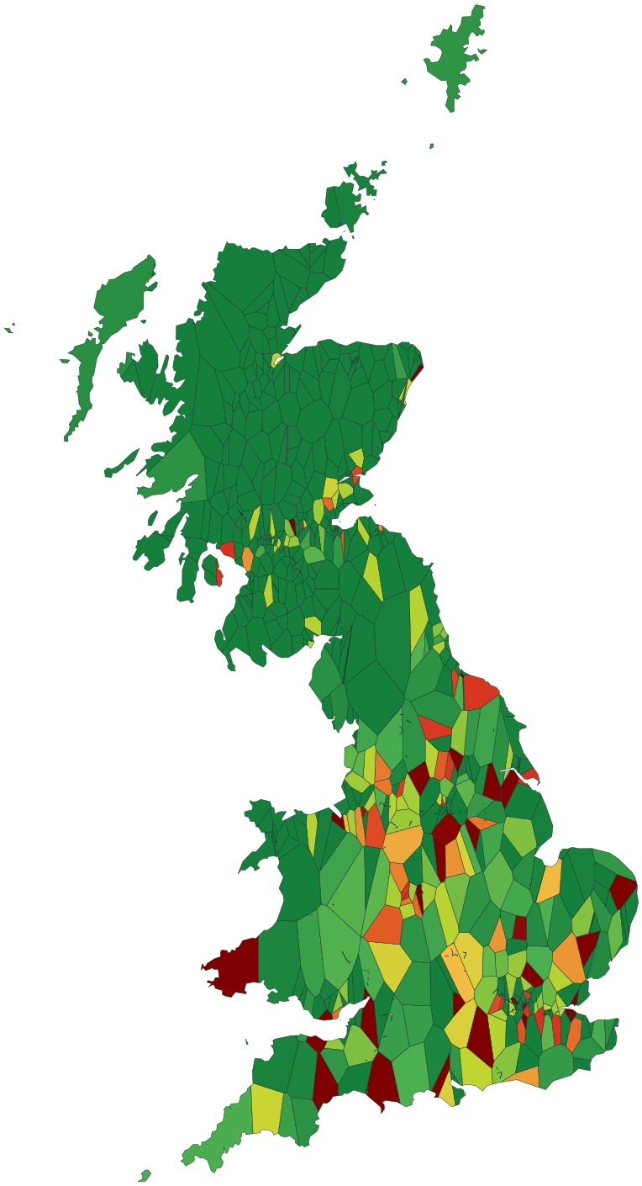
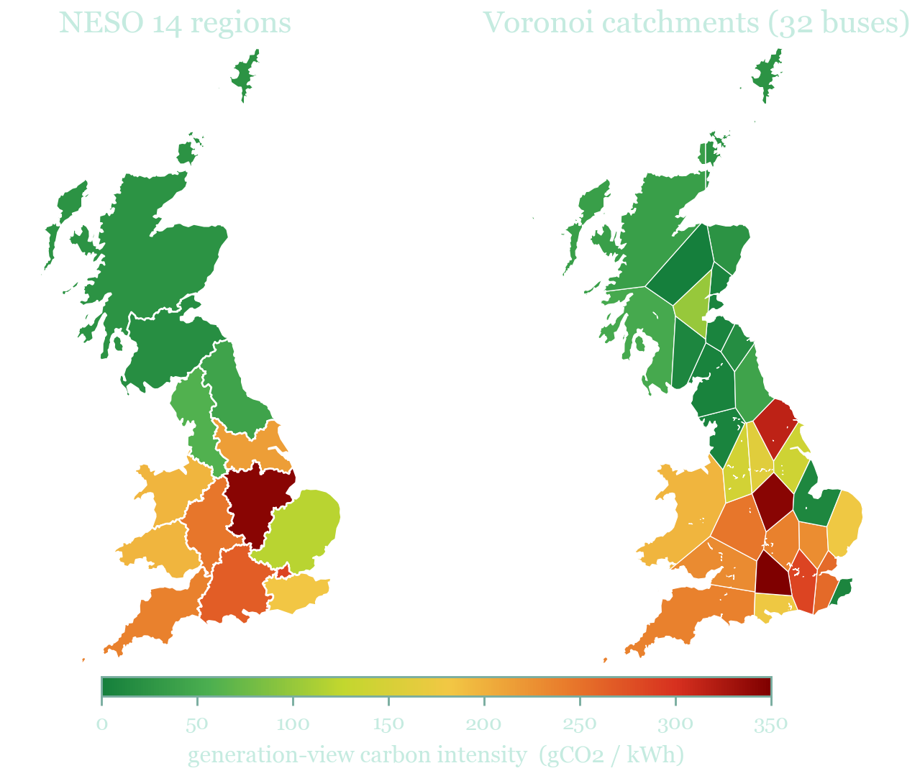
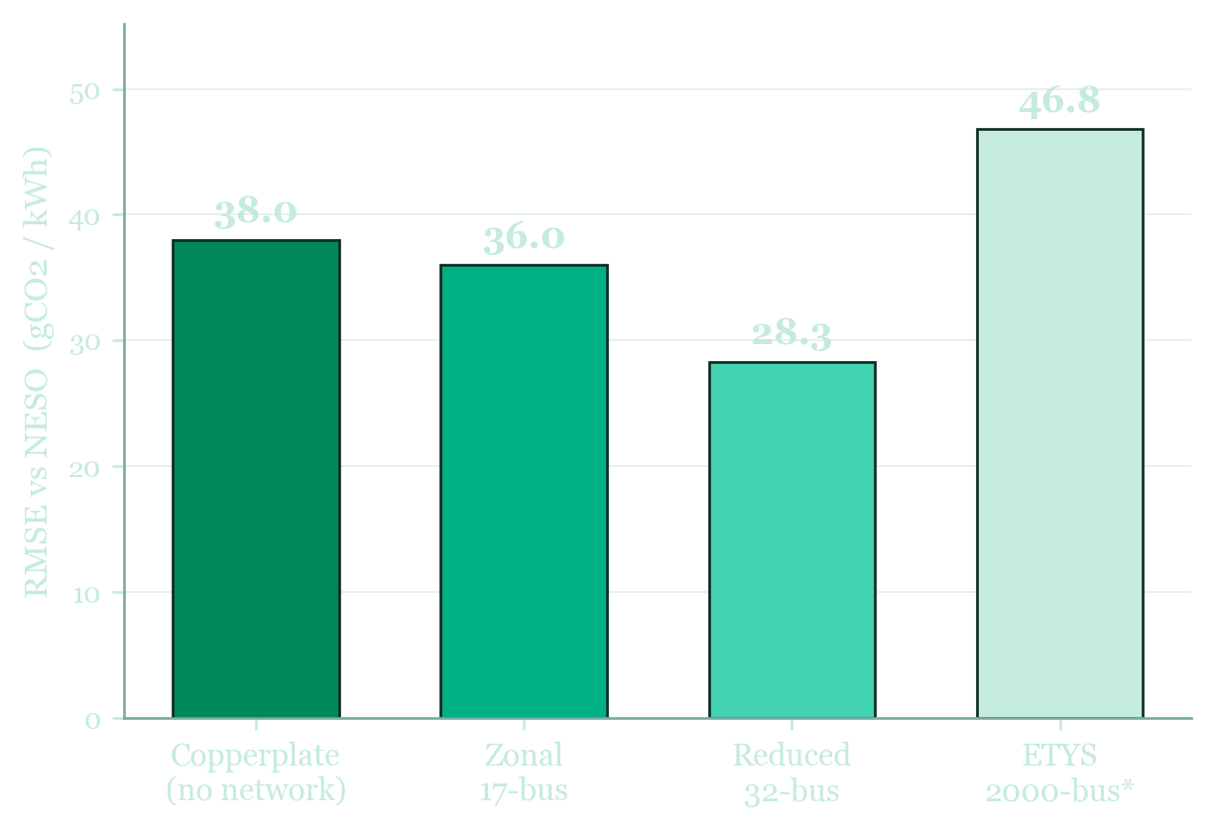
NESO CARBON INTENSITY PROJECT
02
TWO WAYS TO MAP A TOPOLOGY
03
VALIDATION
Imperial College London · ELEC60014 · 2026
Mapping GB Carbon Intensity
NESO regions vs Voronoi catchments
Benchmarked against NESO, hour by hour
The same Reduced 32-bus dispatch, mapped two ways. NESO aggregates buses into 14 statutory reporting regions; Voronoi catchments tessellate GB by nearest bus, keeping every one of the 32 buses distinct.
How network resolution reshapes Britain's carbon map, from a single-node copperplate to 2,000 buses, benchmarked against NESO across full-year 2023.
› Both show the generation view, where emitting plant sits. Scotland (wind, nuclear) stays green; Yorkshire and the south (gas, waste) run hot. › Aggregating to regions hides the within-region spread the catchment view keeps.
ETYS 2,000-bus catchment view, 2023 (provisional). Green = clean, red = carbon-intensive.
Adding network constraints sharpens the hourly fit: RMSE falls 38.0 to 28.3 gCO2/kWh from copperplate to 32-bus. ETYS 2000-bus (provisional) sits highest, a real congestion signature plus an interior-point solve still being tightened.
In collaboration with the National Energy System Operator
Reduced 32-bus · generation view · full year 2023

Slide 2
04
HOW IT WORKS
05
THE TEAM
06
IN SUMMARY
From dispatch to carbon intensity
Who built this
What the comparison shows
1
NESO pull National carbon intensity plus published emission factors: the reference series.
An Imperial College London EEE group project (ELEC60014), in collaboration with the National Energy System Operator.
› Network detail matters: 32-bus constraints lift annual-mean intensity by ~10 gCO2/kWh over an unconstrained copperplate. › 17 and 32 bus agree on the annual mean (within 2 gCO2/kWh) but differ hour to hour by ~16 on average. › Reduced 32-bus tracks NESO best: R 0.936, RMSE 28.3 gCO2/kWh. › Full ETYS 2,000-bus (provisional) carries a real congestion signature: +37 gCO2/kWh vs NESO.
2
PyPSA-GB solve Linear-program economic dispatch on each topology, full-year 2023, Gurobi.
Mert
Annie
3
Carbon intensity NESO factors applied to dispatched generation, summed every hour.
Ava
Matthew
Momo
Adnan
4
Align Hourly UTC, model against NESO, 8,713 matched hours of 2023.
5
Compare Heatmap and interactive dashboard across the four topologies.
Open-source and reproducible, built on PyPSA-GB.
Disclaimer Independent academic study using PyPSA-GB and the NESO Carbon Intensity API. Results are the authors' own and are not produced, endorsed, or validated by NESO. Under default settings (no demand uplift, linear dispatch) the modelled series sit 7 to 9 gCO2/kWh below NESO; the study isolates network topology, not a match to NESO. ETYS 2,000-bus is a provisional interior-point solve.
Default settings: no demand uplift, linear dispatch (no unit commitment), Gurobi LP, pinned PyPSA-GB commit 074ea25e. Every result is regeneratable from the repo.
4
2,130
8,760
topologies
buses (ETYS)
hours
Emission factors (gCO2/kWh): wind/solar/nuclear 0 · biomass 120 · CCGT 394 · coal 937
github.com/avagm/neso-carbon-intensity
Full year 2023 · PyPSA-GB commit 074ea25e · gCO2 per kWh throughout.
PyPSA-GB · NESO Carbon Intensity API · Gurobi
Imperial College London · May 2026
github.com/avagm/neso-carbon-intensity

